Slide 1

Intimacy as a
Techno-Human Symbiosis
Reframing the LLM-User Experience from a
Phenomenological Perspective
Dr Stefano Calzati – Joint Resesarch Centre
10th STS Italia Conference
11-13 June, Politecnico di Milano

Slide 2
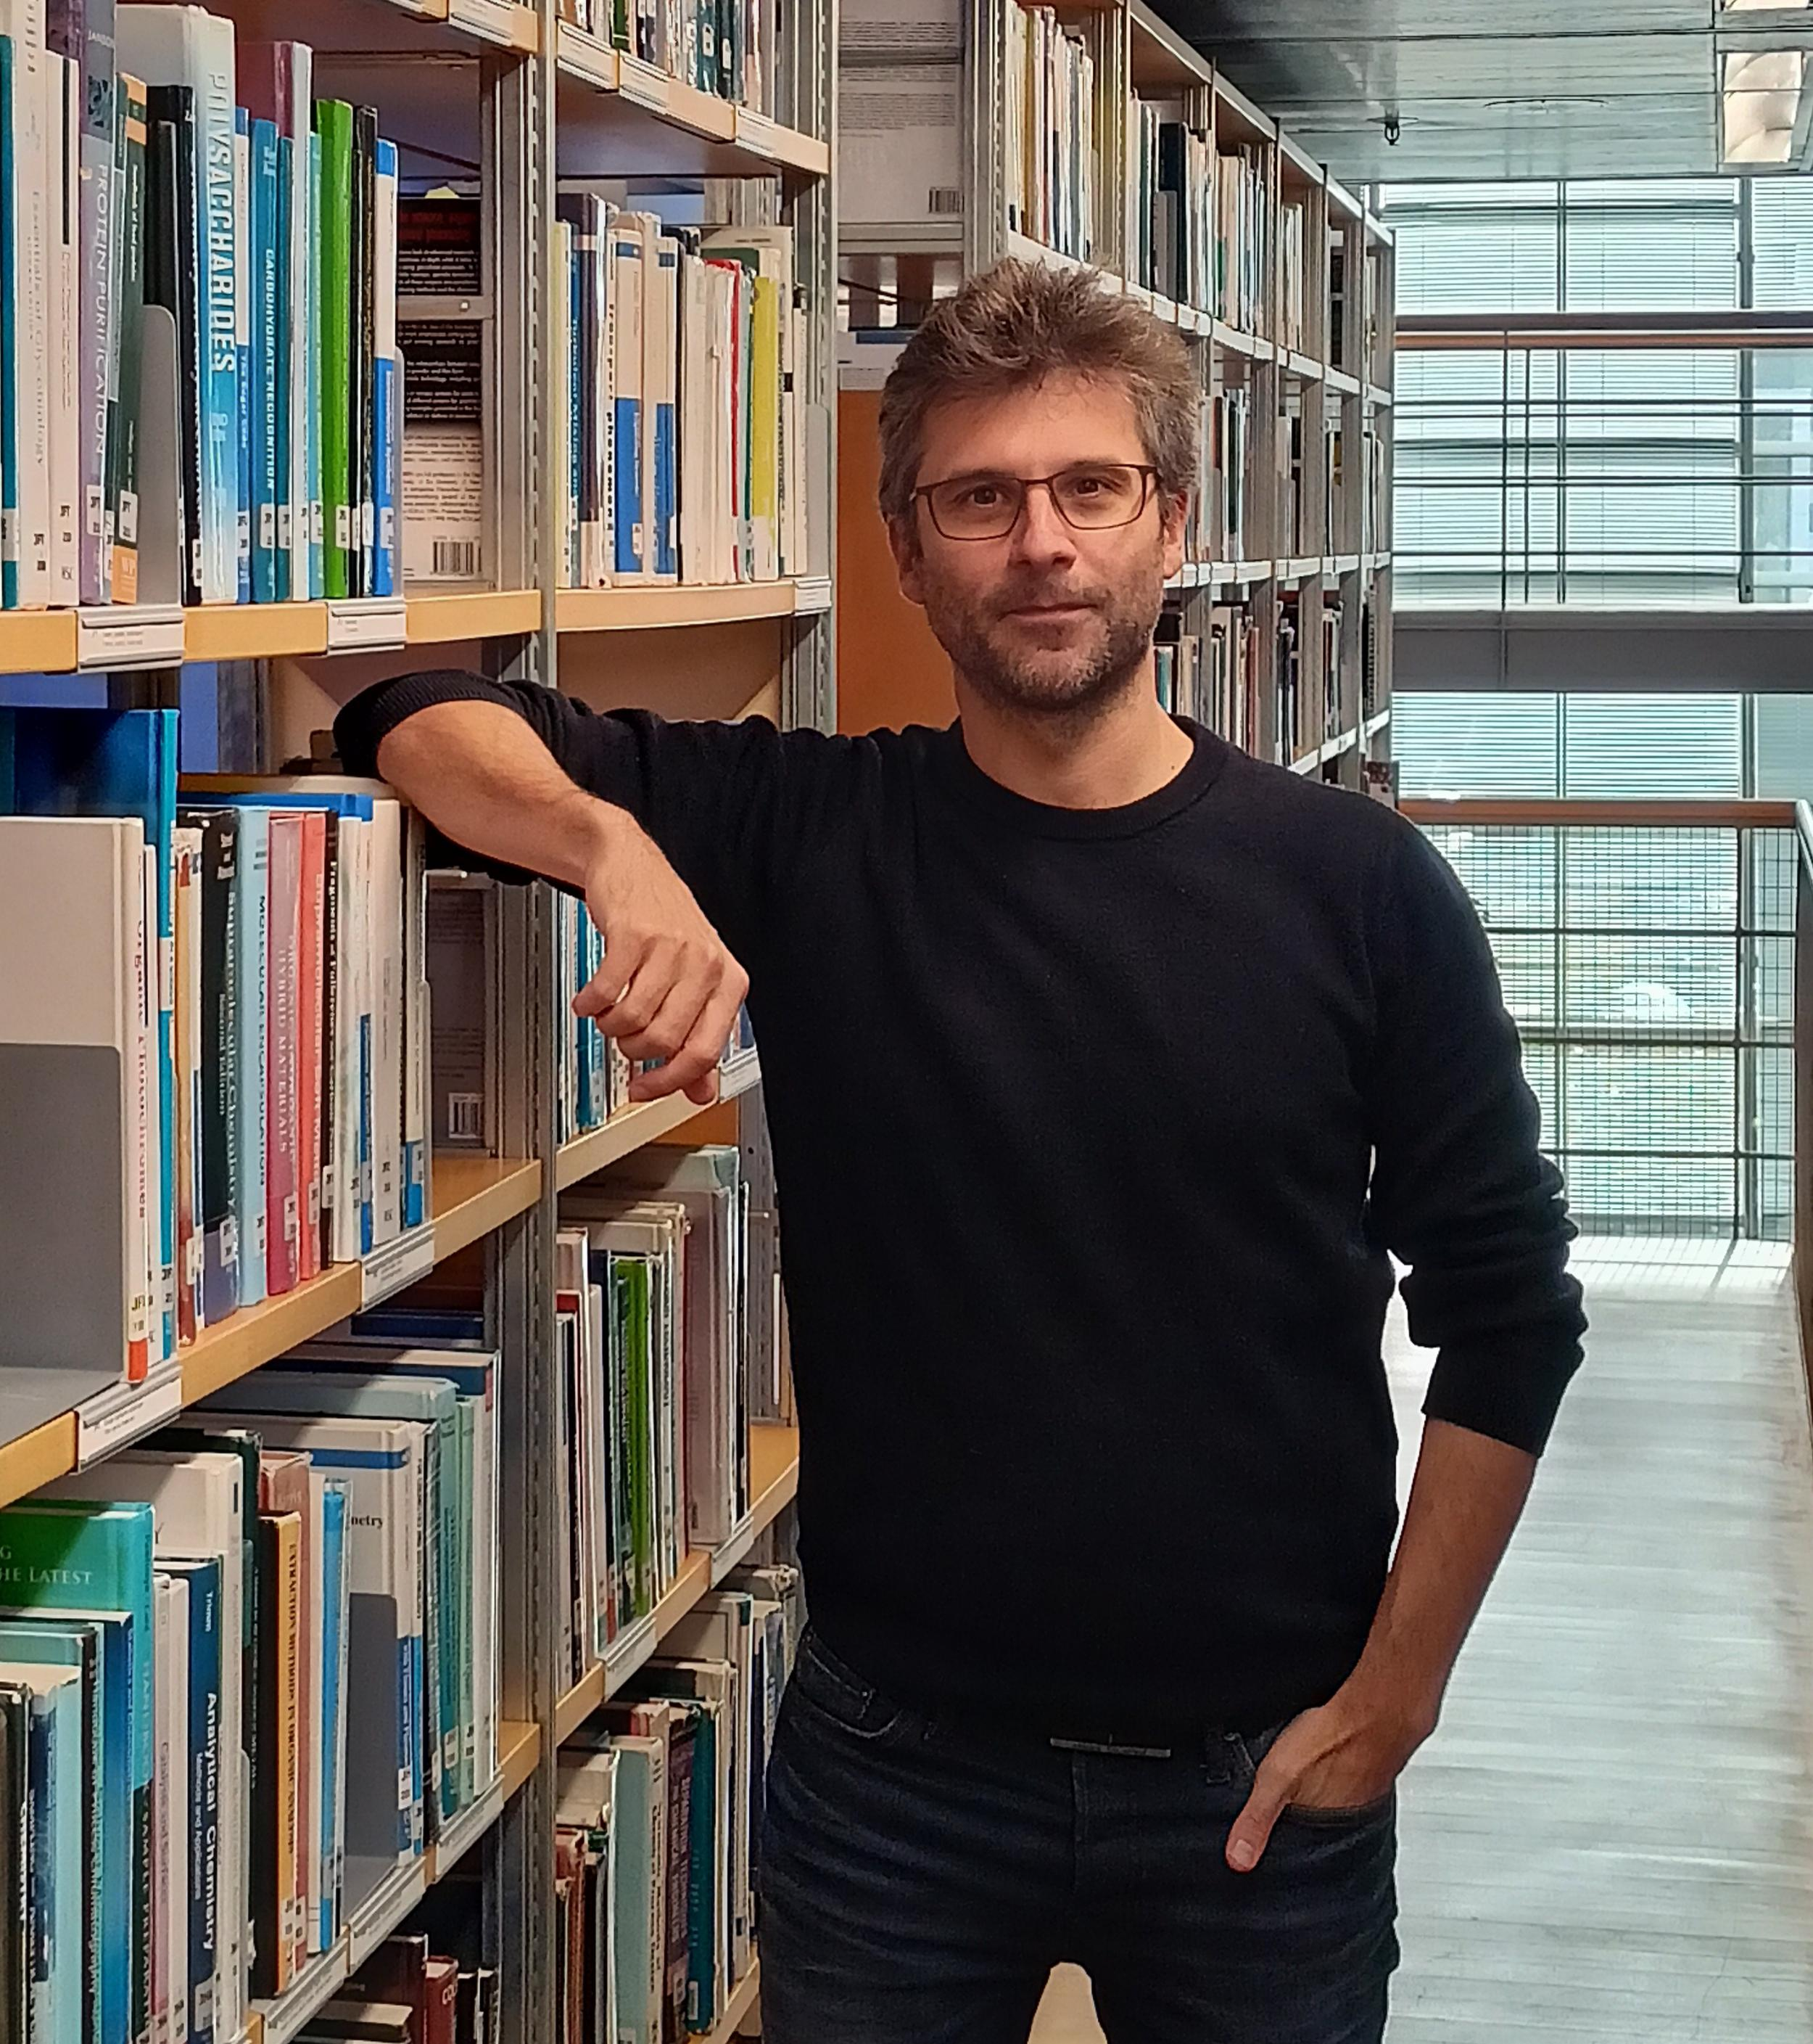

Three (Technological) Ecologies
Language → based on meaningful world-sensing
(e.g., alphabetic & logographic writing systems)
Digital → based on computable world-sensing
(formatting of «sensing» into 0s & 1s)
Quantum → based on a synthetic world-sensing
(both artificial & aggregative)
https://mitpress.mit.edu/9780262546218/quantum-ecology/

Slide 3
Enmeshed Ecologies
LANGUAGE
meaningful world-sensing
DIGITAL
computable world-sensing
Onto-EPISTEMOLOGICAL
DIVIDE

Slide 4
Large Language Models
LANGUAGE
meaningful world-sensing
DIGITAL
computable world-sensing
LLMs
What happens?

Slide 5
Human vs. AI
Most research revolves around an essentialist standpoint
→ LLMs and users are considered as two distinct poles converging through interaction, mutual feedback, and in-the-loop or ex-post supervision (Chang et al. 2024)
Overlooking the dynamic co-evolution of the human-technology hybrid

Slide 6
A Symbiotic Phenomenological Standpoint
“Scientists will need to develop new kinds of probing methods that can yield insight into the mechanisms of diverse types of intelligence and understanding” (Mitchell & Krakauer 2023).
onto-epistemological hybridization of the users-LLMs nexus
symbiotic phenomenological standpoint (cf. Delacroix 2024; Harnad 2024) ≠ & beyond current essentialist standpoint human vs machine
E.g. Ashery et al (2025): results showing emergent collective conventions in grouped LLMs

Slide 7
Agenda
Instead of benchmarking machine intelligence vs human intelligence…
… explore the effects and affects that the LLMs-user symbiotic experience produces and on knowing as an embodied process and knowledge as an embodied output
Is it possible to detect patterns across the LLM-user symbiotic experiences?
To what extent does the LLM-user symbiotic experience lead, in the longer run, to forms of idiosyncratic knowing/knowledge?

Slide 8
Three Axes
1) Entanglement between prompts and generated outputs through longitudinal and comparative studies (involving diverse users, LLMs, and writing systems over time)
converging and/or diverging meaning-making patterns or evidence of randomization
2) Mapping «hallucinations» both longitudinally and comparatively
Evidence for their rhapsodic nature or as traces of a broader techno-human onto-epistemology in the making
3) Affects of the LLM-user symbiosis in terms of perceived (by different users) contextual fitness and finesse of the outputs

Slide 9
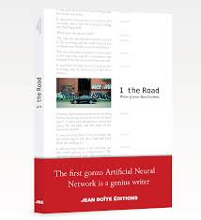
Before the Hype
1 the Road (2018), by AI
Ross Goodwin (former Google cs) trained a neural network with over 360 megabytes of literature
AI installed onto a ‘powered’ Cadillac (GPS, clock, camera, microphone and a receipt printer)
Travel from New York to New Orleans
The road as a source of inspiration for the AI

Slide 10
The Text’s Features
Numerical notations of geolocation
Dialogues between Goodwin and his companions
Fictional characters created by the AI, e.g., a painter simulacrum of Goodwin; the car itself as part of the story → mise en abyme of the AI into the text
Images captured by the camera and translated into words:
“The train was already being darkened, and the street was already there”
“The time was one minute after midnight and the wind was still standing on the counter and the little patch of straw was still still and the street was open”

Slide 11
Considerations
The text does configure a travel narrative
Literary pleasure coming from either:
the text’s internal inconsistency, oddities as trademarks (cf. 1900s avant-gardes)
meta-level fascination of reading a travel account written by an AI
The text is:
manifestly intertextual
a synesthetic site of techno-human negotiation
A form of artificial hypomnemata: “a material memory of things read, heard, or thought, thus offering these as an accumulated treasure for rereading and later mediation” (Foucault 1997)
AI hypomnemata as a techno-agent (if not self?) in the making (?)

Slide 12
THANK YOU!
Personal website: https://stefanocalzati.com
Email: stefano.calzati@ec.europa.eu

