Slide 1

Through the Lens of Quantum Ecology
Holographic Bodies and Inconsistent Agents
Dr Stefano Calzati – Joint Research Centre
10th STS Italia Conference
11-13 June, Politecnico di Milano

Slide 2
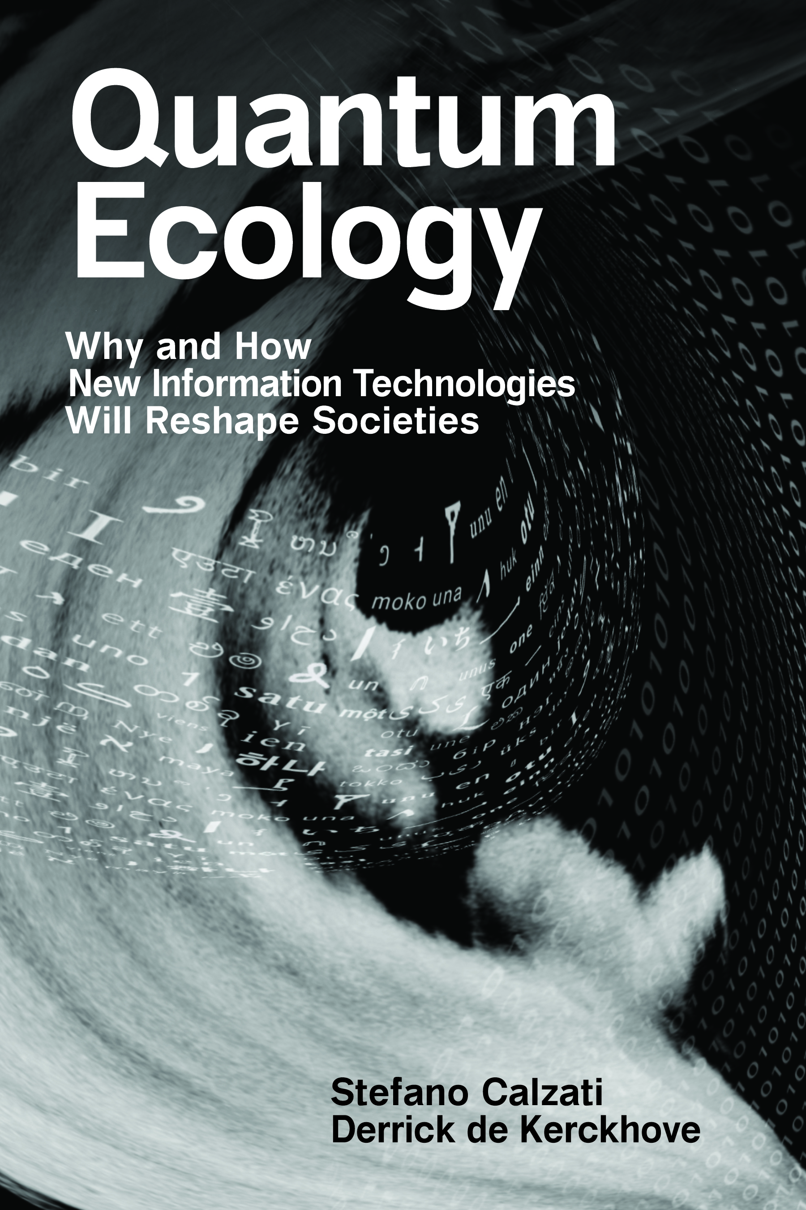
Three (Technological) Ecologies
Language → based on meaningful world-sensing
(e.g., alphabetic & logographic writing systems)
Digital → based on computable world-sensing
(formatting of «sensing» into 0s & 1s)
Quantum → based on a synthetic world-sensing
(both artificial & aggregative)
Partial onto-epistemological incommensurability
Partial onto-epistemological incommensurability

Slide 3
Key Ideas
Dispositif: “the capacity to capture, orient, determine, intercept, model, control, or secure the gestures, behaviors, opinions, or discourses of living beings” (Agamben, 2009).
Dispositio as “organization, arrangement” → the dispositio configured by/through a dispositif is always «from within» (cf. Haraway 1988)
Dispositif/dispositio are complementary, the former stressing the point-of-being in the world (de Kerckhove & Almedia 2016), the latter its outer (open) horizon of becoming
Autopoiesis: the ability of a system to process information, self-organize as a unity and remain so over time (Maturana & Varela 1980) → Autopoiesis as the key forming principle of any ecology
Agency as autopoietic Information-processing: as soon as there is perception, there is cognition (Kauffman 2019) → sensing as emergent embodiment (from within)

Slide 4
Onto-epistemological paradigm, whose pillars are discreteness, entanglement, uncertainty
Technological paradigm, pivoting around emerging Quantum Information Technologies (QITs)
I will refer to both, introducing a fourth ecology, that of the body, which anticipates the other three

Slide 5
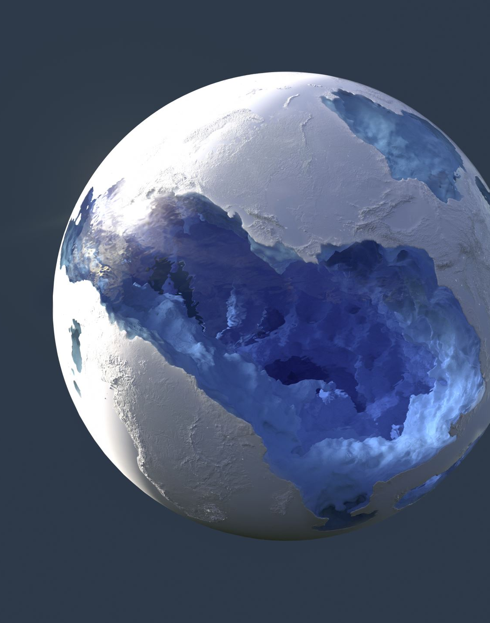
Why an ecology of the body
An inescapable ecology: «Information is not a disembodied abstract entity; it is always tied to a physical representation.» (Landauer 1996)
→ the body instantiates the emergent codevelopment of the agent-world symbiosis
Root, compass, and epicentre of experience:
«experience as the irreducible wellspring of knowledge» (Frank et al 2024)
→ to be(come) is to know, or sensing
Autopoietic information-processing dispositif/dispositio:
«the experience of meaning can thus be understood as a (‘sixth’) sense modality for ‘perceiving’ psychophysical correlations» (Atmanspacher 2020)
→ the body as the complementary enactment of focus & framing

Slide 6
The Body Ecology as a Fractal Hologram
A fractal is a topological and temporal (re)configuration of a never-ending pattern
→ from the micro to the macro scale, a fractal always already contains its own autopoietic be-coming
In a hologram, «the whole is present in the parts, not made up of them” (Wendt 2015)
→ a hologram, at once, embodies its dispositif and materializes a certain framing

Slide 7
Theoretical Implications
The body as an ecology cuts through and reworks onto-epistemological boundaries: individual vs collective; organic vs artificial; nature vs culture
Individual and collective body(ies) are mutually implicated
the organic body is always already a culturized dispositif, and culture as a dispositio finds inevitable particularization through bodies
agnostic understanding of agency (neither necessarily human, nor even organic)
The body as a “collectual” (collective+individual) biocultural agent-agnostic ecology

Slide 8
Practical Implications – 1
Identity emerges and is enacted as a decomposed, yet unitary, dimension – a dimension that, while being whole, can host internal inconsistency, both intra-ecologically as well as inter-ecologically (e.g., gender fluidity, non-binarism, etc.)
To be and to know – i.e., to sense – are co-depedent sides which entail uncertainty intended as non-predetermined, open-ended, and trans-subjective processes
This requires:
the recognition of ecology-dependent co-existing identities
an exercise of responsibility and balance toward such identity pluralities

Slide 9
Practical Implications – 2
Pervasive computing «envelops» (Floridi 2019) reality into a rational-efficient scenario
Envelopment fits computational agents but less so organic beings → implosion of the «rational subject»
e.g., electromagnetic sensitivity as a psychophysical response to the engineering of capillary “observership” (Hertog 2023) into today’s all-encompassing networks
Similar responses will multiply alongside the consolidation of QITs – such as ultraprecise quantum sensing – as forms of diffraction in the sociocultural realm of the complementarity between being and becoming, i.e., one’s own identification (as pinning) and one’s own movement (as change)

