Slide 1

The Making of a Communitarian Quantum Ecology
Ideas for a Republican Governance for
Quantum Information Technologies
Dr Stefano Calzati – Joint Reserarch Centre
Dr Luca Possati, University of Twente
10th STS Italia Conference
11-13 June, Politecnico di Milano

Slide 2
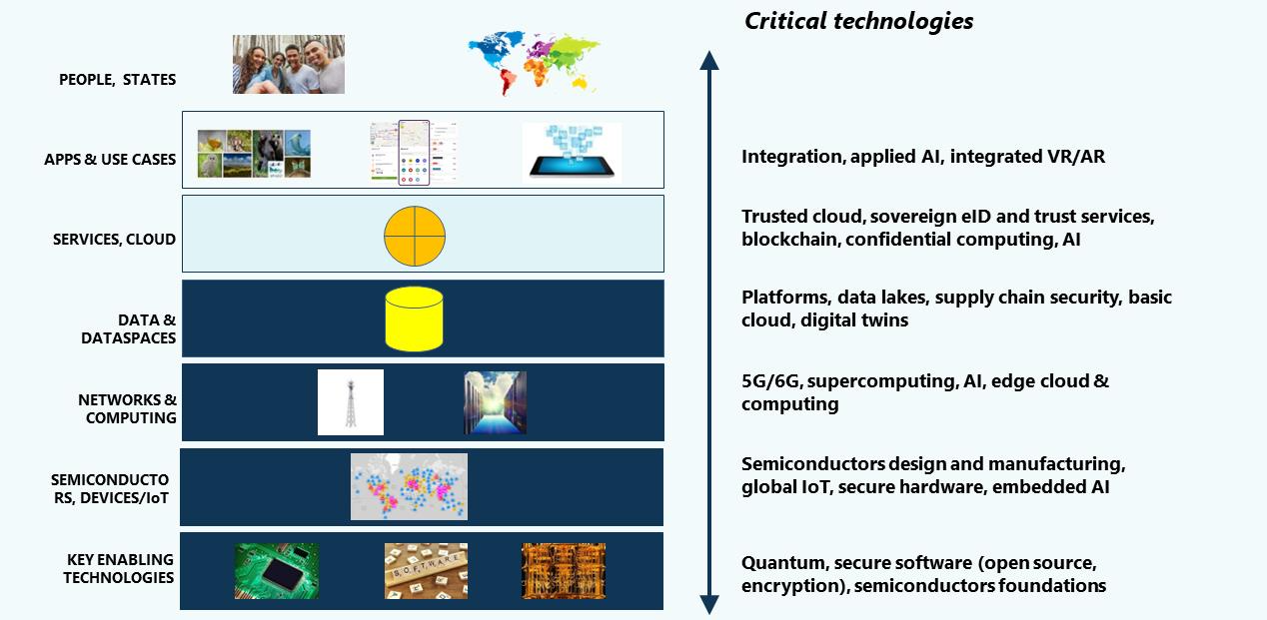
QITs as Enabling Technologies & Pharmakon
Second quantum revolution
(Dowling & Milburn 2003), from quantum-enabled techs to QITs
QITs as a pharmakon (Calzati & de Kerkchove 2024) both opportunity & threat (Taylor 2020)
Technology stack (Timmers 2023)

Slide 3
Towards QITs Governance
Research on QITs’ ELSPI (Kop 2021, 2025; de Jong 2022)
Research on QITs RRI (Coenen & Grunwald 2017)
Focus on QITs governance:
a) how we want to manage QITs
c) nature of this «we»
b) why

Slide 4
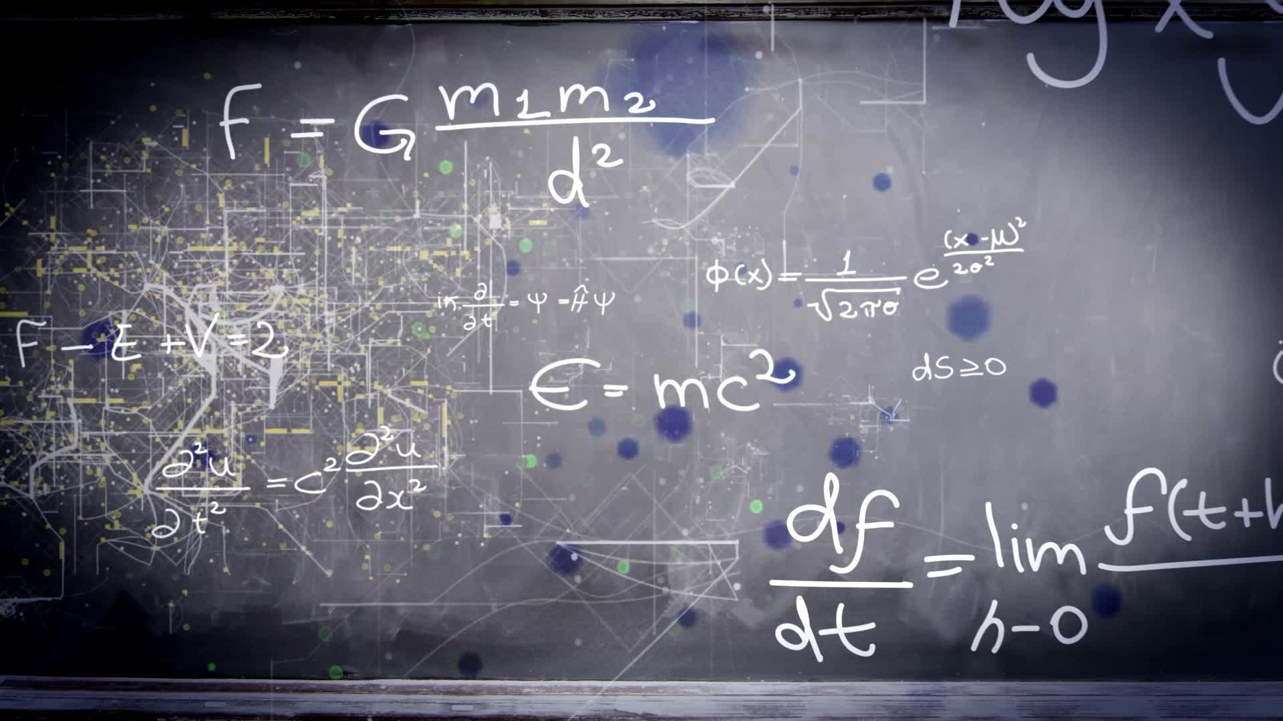
Governance Approaches to QITs
Normative proposals already exist (Perrier 2022; World Economic Forum 2022)
path dependent (QITs like previous technologies)
risks of reinforcing/exacerbating the status quo, notably:
a) private vs. public siloing (Shelley-Egan & Vermaas 2025)
b) geopoliticization of QITs (Taddeo et al. 2024)

Slide 5

Quantum Ecology
Based on the philosophical tenets behind quantum physics – such as uncertainty, entanglement, discreteness – the emerging quantum ecology, which pivots around QITs as dispositifs, is communitarian:
“In fact, community is a ‘negative’ concept: it derives for cum + munus (‘duty together’), denoting a bond among people based on necessity. In other words, the communitarian bond rests on a gap, a fundamental condition of deficiency. Humanity can be self-sufficient only as a whole.”
(Calzati & de Kerckhove 2024)

Slide 6
Quantum Republic
How to operationalize a communitarian governance for QITs?
Non-proliferation treaty – Game theory (Calzati & de Kerckhove 2024; Kop 2025)
+
Republican approach to technology governance
(Susskind 2022; Calzati & van Loenen 2023; Hoekmstra 2024)
A republican approach moves away from prioritizing either certain actors (e.g., private or public), values (e.g., economic competitiveness vs sustainability), or factors (e.g., legal and technical specifics over soft skills) to rather enact a fair ecosystem (i.e. “balance”, cf. Rochel 2021) whereby actors, factors, and values are tackled as co-dependent aspects of a whole emerging sociotechnical arena.

Slide 7
Six Tenets
1. Management of (tech) resources by the (glocal) community/ies and for the community/ies (republic as politeia)
2. Distribution and accountability of power(s) (Susskind 2022)
3. QITs governance as a systemic affair, not simply one of agency (Hoekmstra 2024)
4. Governance as an exercise of balance across individual (quantum) interests and the collective good (Calzati & van Loenen 2023)
5. Modular governance across scales, sectors, contexts – global principles, local implementation (Calzati & de Kerckhove 2024)
6. QITs governance as an open-ended process, devising internal roles, rules, and mechanisms

Slide 8
Way Forward
Identification of bodies, principles and processes to enact a republican approach, based on the 6 tenets
Works blending digital republicanism + QITs & international relations (Hoekmstra 2024; Kop 2025) + (quantum) game theory (Busemeyer & Bruza 2012)
Transdisciplinarity: contributions from diverse disciplines, sectors, and stakeholders (beyond the quadruple helix; cf. EuroQCI) + uncertainty and entanglement of intersts at its core

